Slide 1

INTERNET BANKING
Aisah Taufik Hidayat Abdullah
Student of G2 Academy

Slide 2
Internet Banking
an electronic payment system that enables the customer of a bank or a financial institution to make financial or non-financial transactions online via the internet.
This service gives online access to almost every banking service, traditionally available through a local branch including fund transfers, deposits, and online bill payments to the customers.
Internet banking can be accessed by any individual who has registered for online banking, having an active bank account or any financial institution.
After registering for online banking facilities, a customer need not visit the bank every time he/she wants to avail a banking service. It is not just convenient but also a secure method of banking. Internet banking portals are secured by unique User/Customer IDs and passwords.

Slide 3








Front-End – Tech

Slide 4
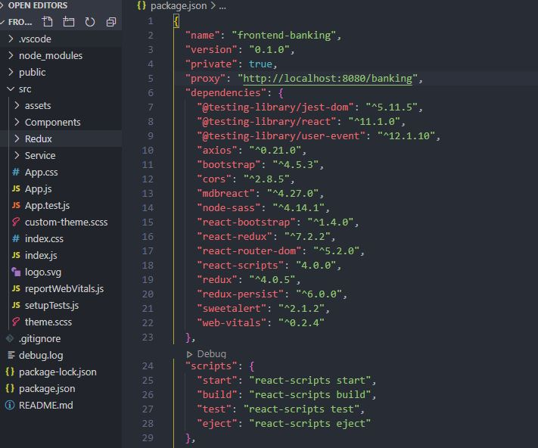
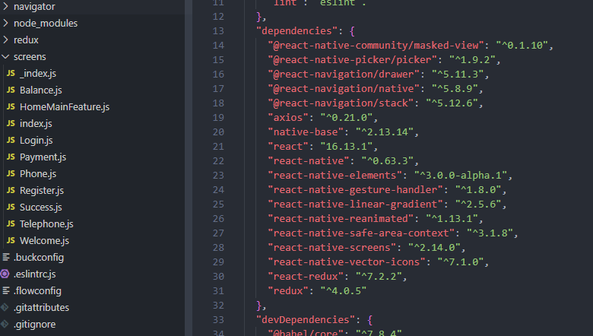
Front-End – Dependencies

Slide 5







Back-End - Tech

Slide 6
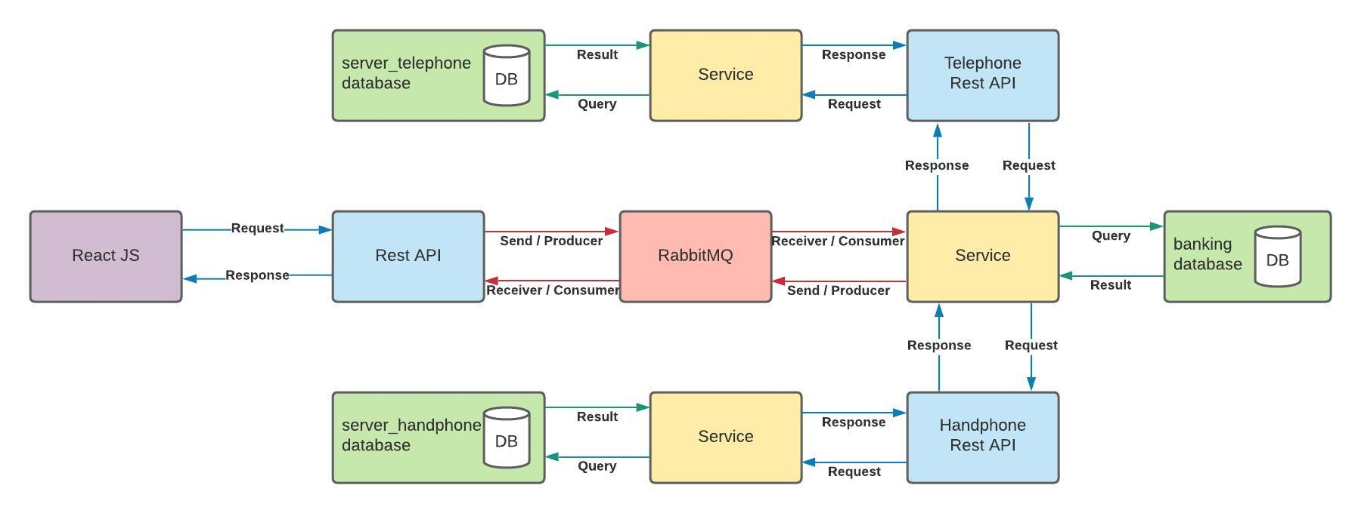

Program Flow

Slide 7
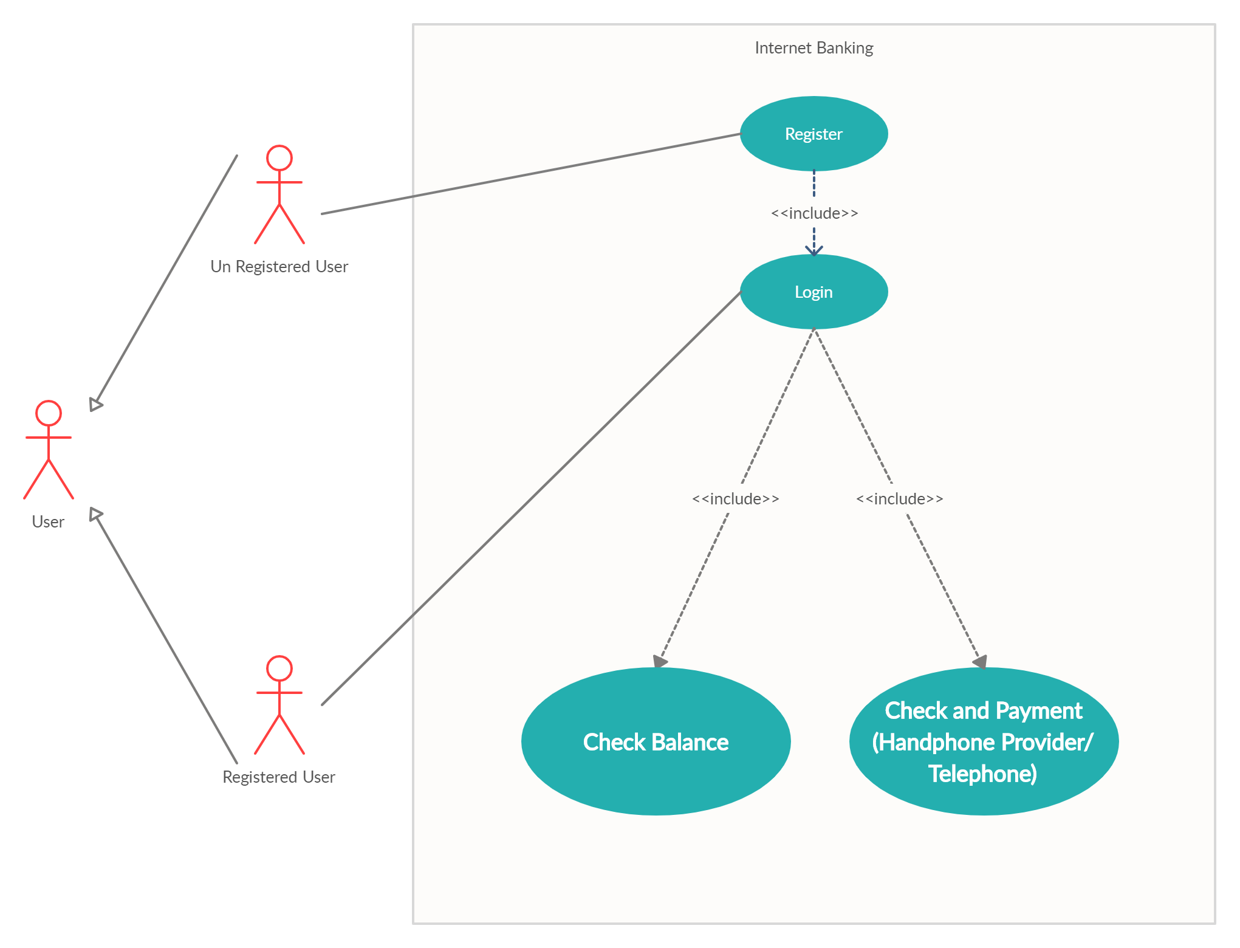
Use Case Diagram

Slide 8
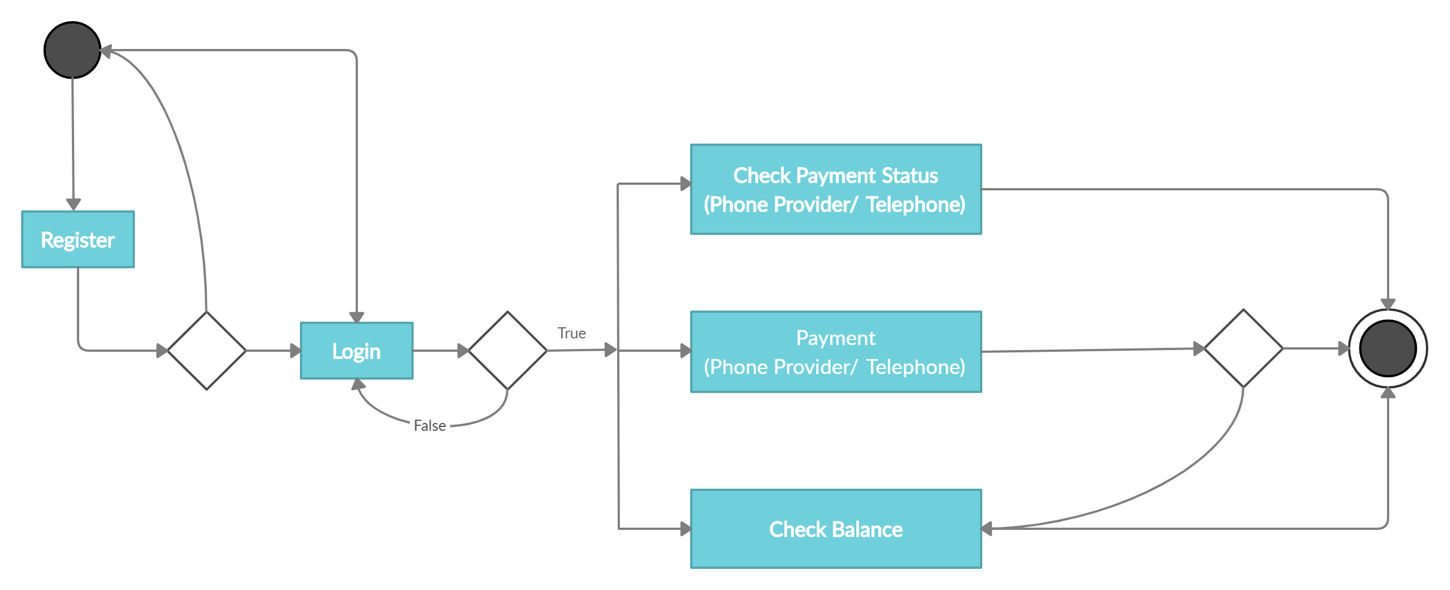
Activity Diagram

Slide 9
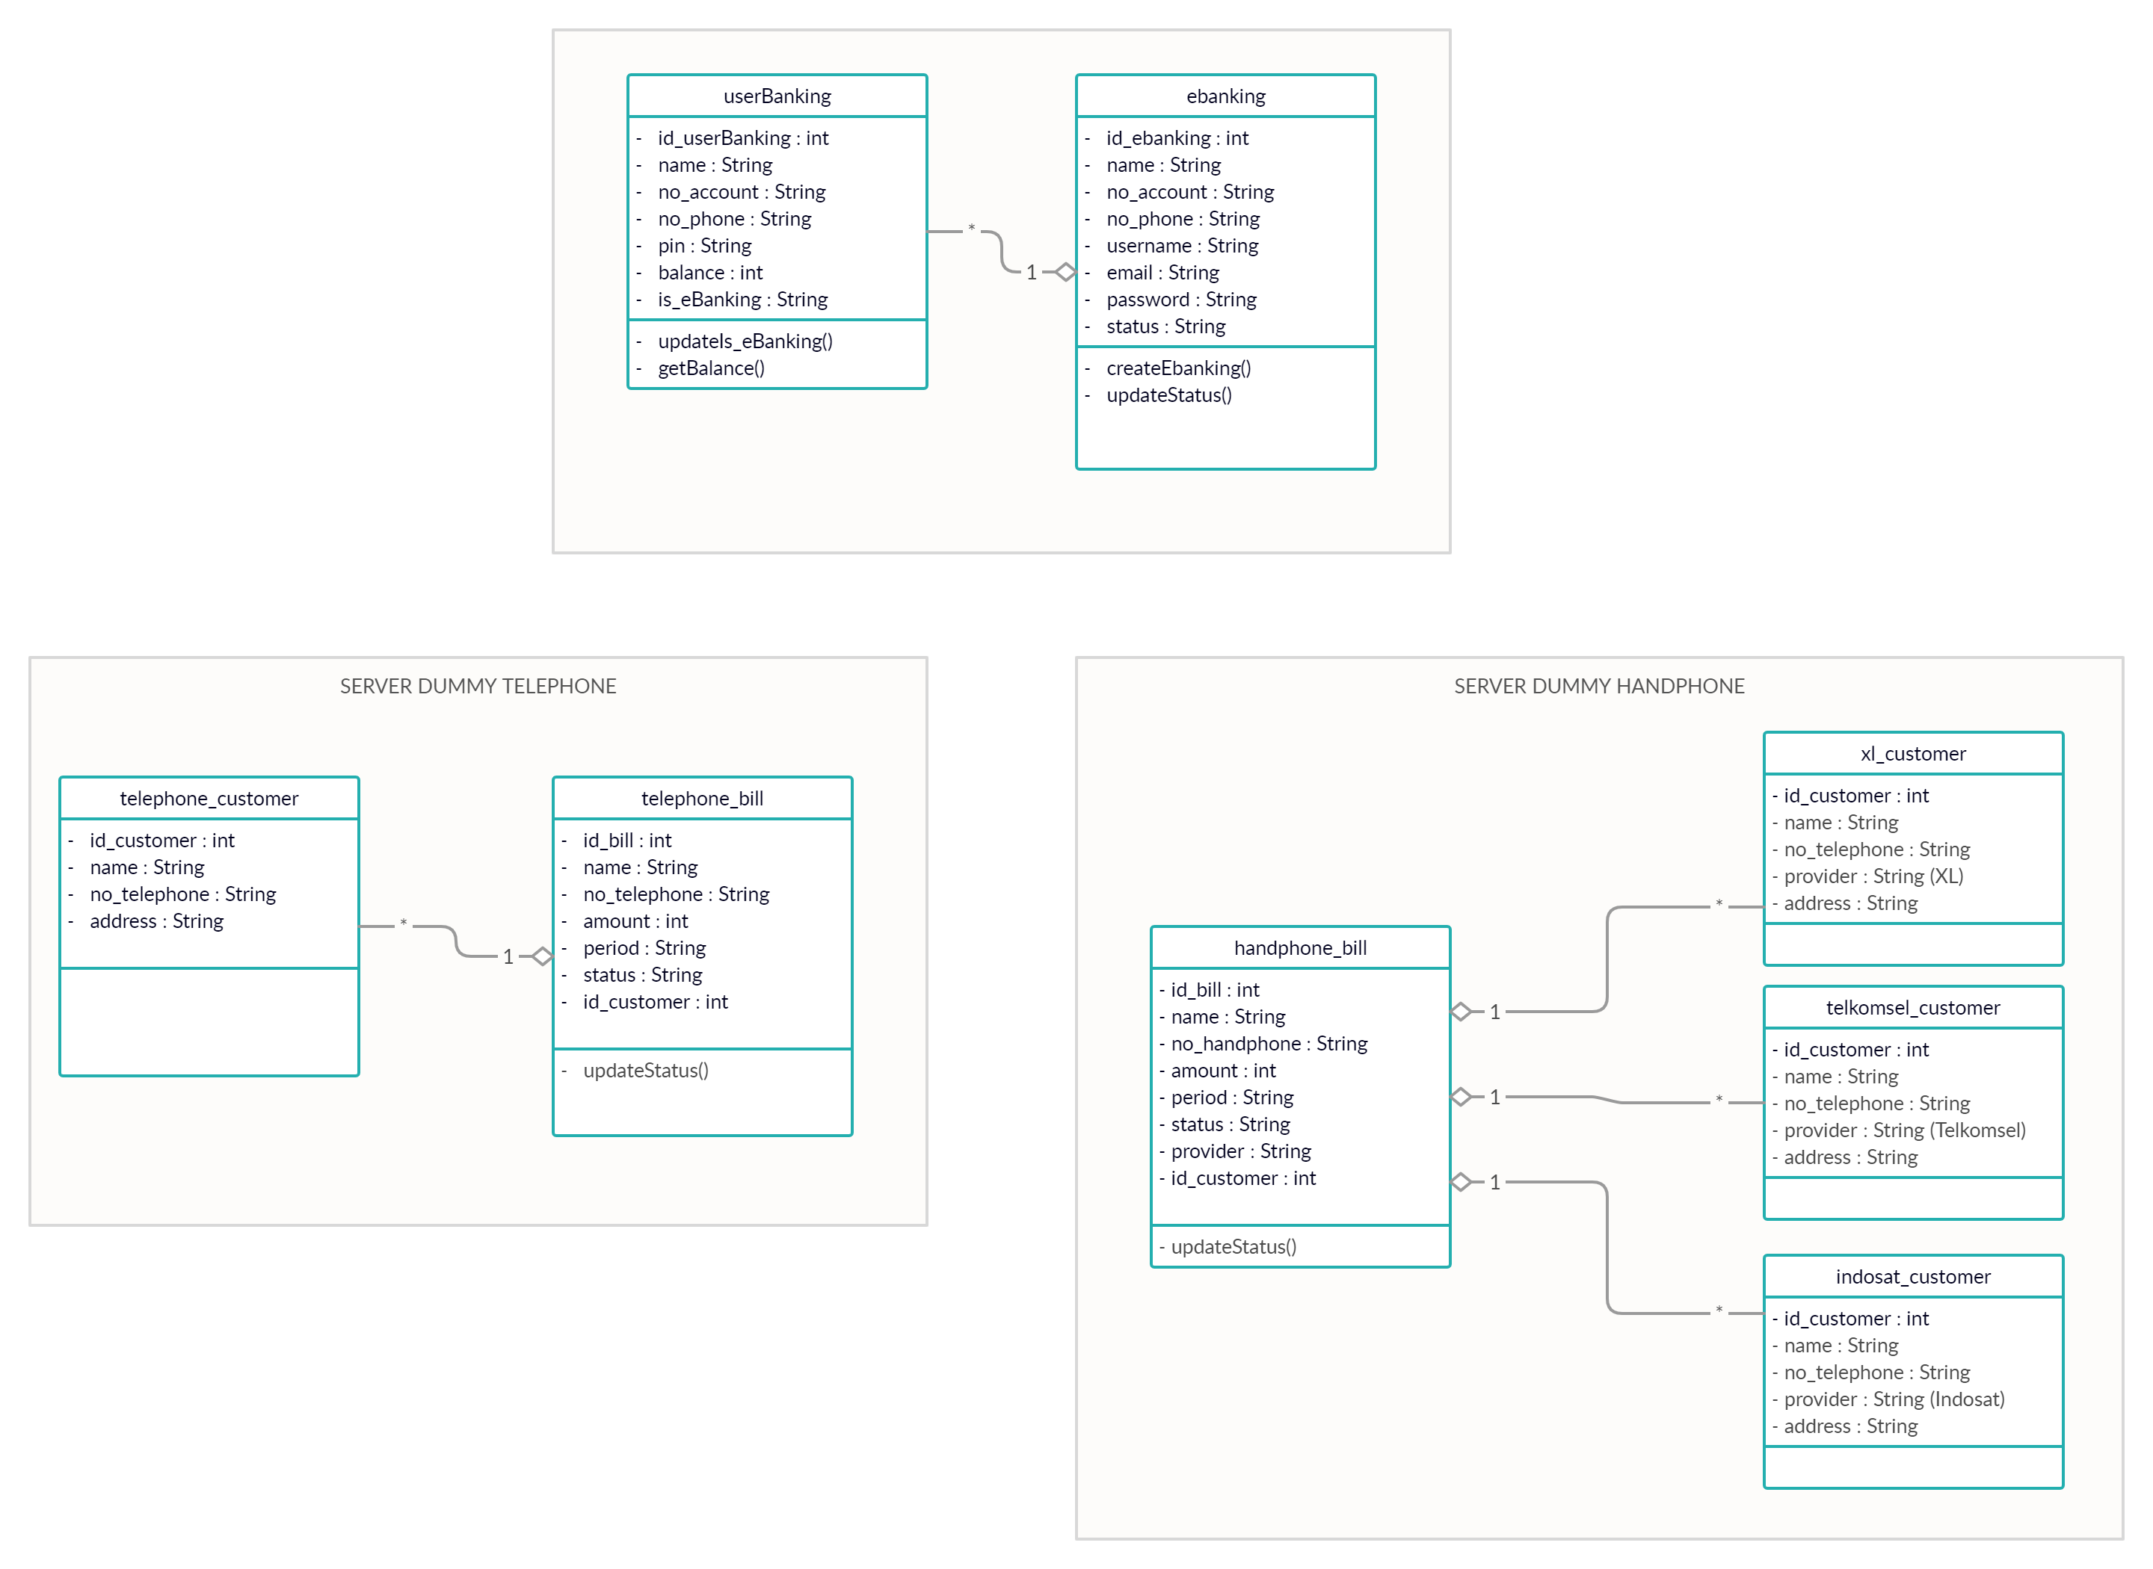
Class Diagram

Slide 10
Internet Banking Features
Registration
Login
Logout
View Balance
Telephone/ Telkom
Check Bill
Payment
Postpaid Phone
Check Bill
Payment

Slide 11
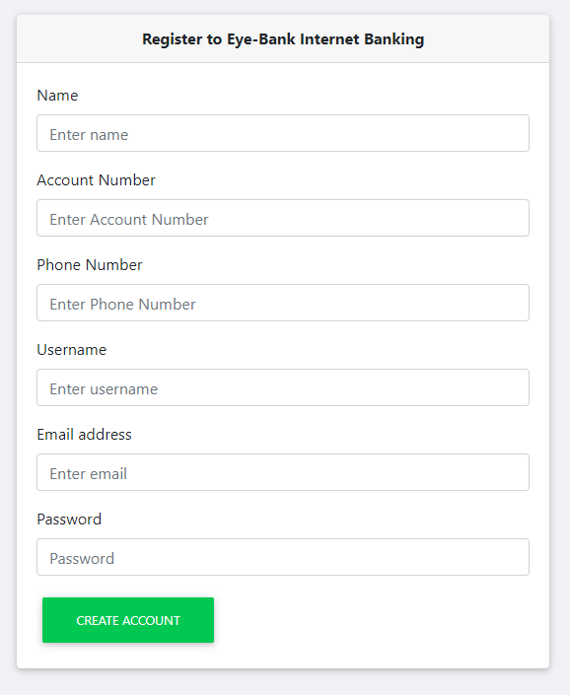
Registration
API Path
POST
http://localhost:8080/banking/register
Request Body
{
"name" : "Aisah",
"no_account" : 123456789,
"no_phone" : "82233445566",
"username" : "aisyah",
"email" : "athaisyahh@gmail.com",
"password" : "aisyah123"
}
Respone Body
{
"message": "Registration eBanking success. "
}

Slide 12
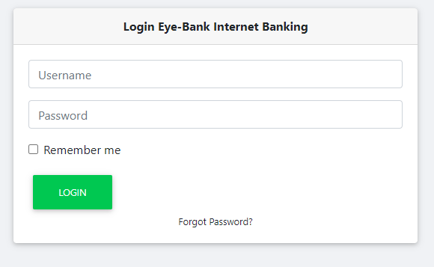
Login
API Path
POST
http://localhost:8080/banking/login
Request Body
{
"username" : "aisyah",
"password" : "aisyah123"
}
Respone Body
{
"message": {
"User": "aisyah success login"
}
}

Slide 13
Logout
API Path
POST
http://localhost:8080/banking/logout
Request Body
{
"username" : "aisyah",
"password" : "aisyah123"
}
Respone Body
{
"message": "Successfully logout from eBanking. "
}

Slide 14
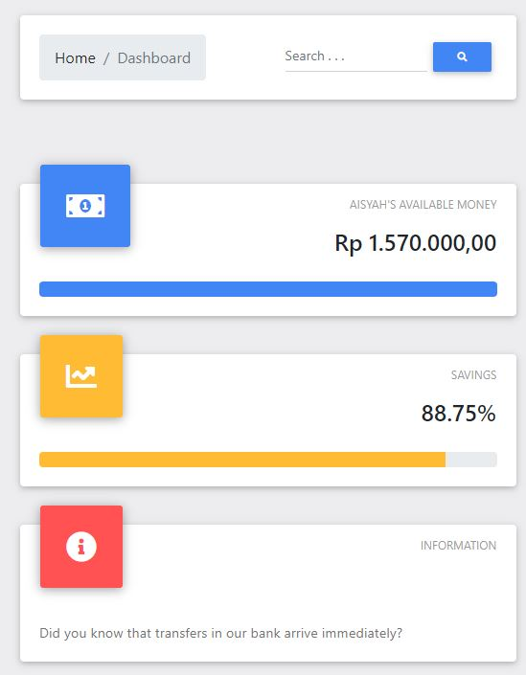
View Balance
API Path
POST
http://localhost:8080/banking/balance
Request Body
{
"username" : "aisyah",
"password" : "aisyah123"
}
Respone Body
{"message" :
{
"Balance" : 2000000
}
}

Slide 15
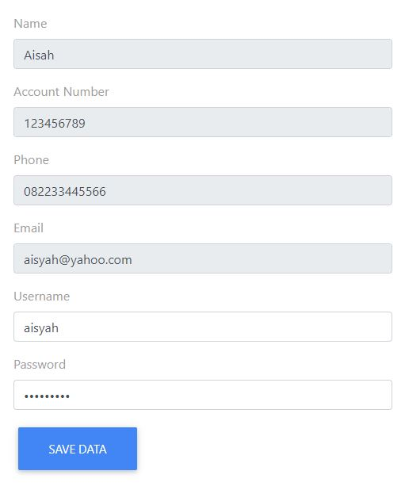
View Profile
API Path
POST
http://localhost:8080/banking/profile
Request Body
{
"username" : "aisyah",
"password" : "aisyah123"
}
Respone Body
{
"message": {
"Name": Aisah,
"Account_no": 123456789,
"Phone": 82233445566,
"Email": athaisyah@gmail.com,
"Username": aisyah,
"Password": aisyah123,
}
}

Slide 16
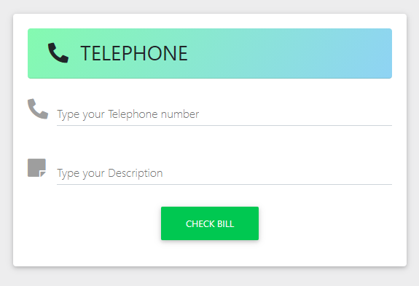
Telephone Bill
API Path
POST
http://localhost:8080/banking/telephone
Request Body
{
"telephoneNumber" : 21111222,
"username" : "aisyah",
"password" : "aisyah123"
}
Respone Body
{
"message" : {
"Name" : "Aisah",
"Telephone" : "21111222",
"Period" : "November 2020",
"Amount" : 85000,
"Status" : "Waiting for payment"
}
}

Slide 17
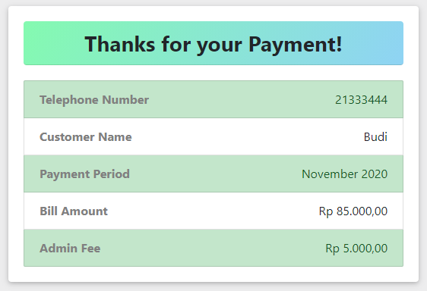
Telephone Payment
API Path
POST
http://localhost:8080/banking/telephone/payment
Request Body
{
"telephoneNumber" : 21111222,
"username" : "aisyah",
"password" : "aisyah123"
}
Respone Body
{
"message" : "Thanks for payment.",
"messageDetail" :
{
"Name" : "Samirah",
"Telephone" : "21222333",
"Period" : "November 2020",
"Amount" : 85000,
"Status" : "Paid"
}
}

Slide 18
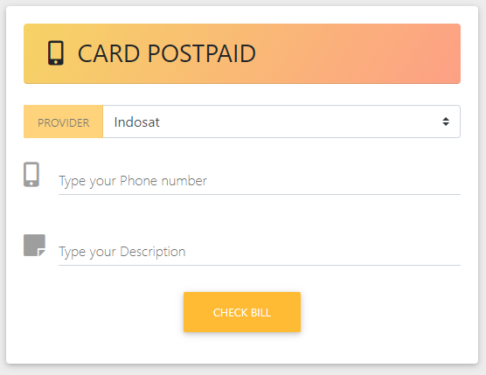
Handphone Bill
API Path
POST
http://localhost:8080/banking/handphone
Request Body
{
"handphoneNumber" : 82233445566,
"username" : "aisyah",
"password" : "aisyah123"
}
Respone Body
{
"message": {
"Name": "Alika",
"Handphone": "82233445566",
"Period": "November 2020",
"Amount": 150000,
"Status": Waiting for Payment,
"Provider": "XL"
}
}

Slide 19
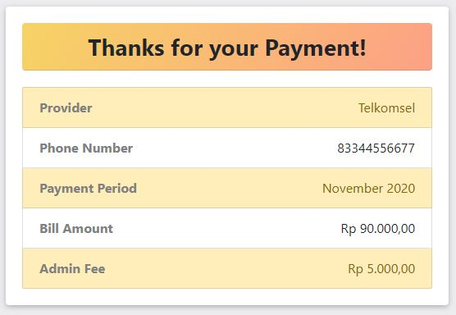
Handphone Payment
API Path
POST
http://localhost:8080/banking/handphone/payment
Request Body
{
"handphoneNumber" : 82233445566,
"username" : "aisyah",
"password" : "aisyah123"
}
Respone Body
{
"message": "Thanks for payment.",
"messageDetail":
{
"Name": "Alika",
"Handphone": "82233445566",
"Period": "November 2020",
"Amount": 150000,
"Status": Paid,
"Provider": "XL"
}
}

Slide 20
Lets Go To Application Demo ☺

Slide 21
THANK YOU ☺

Slide 22
Front-End – Web Banking App

Slide 23
Front-End - Banking App

